Slide 1
Design for Change Patterns & Principles
Notes:
‹#›

Slide 2
What's a design pattern?
Design patterns are typical solutions to commonly occurring problems in software design. They are like pre-made blueprints that you can customize to solve a recurring design problem in your code.
Design patterns represent the best practices used by experienced object-oriented software developers. Design patterns are solutions to general problems that software developers faced during software development. These solutions were obtained by trial and error by numerous software developers over quite a substantial period of time.

Slide 3
Best Practices
Design patterns have been evolved over a long period of time and they provide best solutions to certain problems faced during software development. Learning these patterns helps unexperienced developers to learn software design in an easy and faster way.

Slide 4
History of GoF
Over 20 years ago the iconic computer science book “Design Patterns: Elements of Reusable Object-Oriented Software” was first published.
The four authors of the book: Erich Gamma, Richard Helm, Ralph Johnson, and John Vlissides, have since been dubbed “The Gang of Four”.
According to these authors design patterns are primarily based on the following principles of object orientated design.
Program to an interface not an implementation
Favor object composition over inheritance

Slide 5
Coding to interfaces
Coding to interfaces is a technique to write classes based on an interface; interface that defines what the behavior of the object should be. It involves creating an interface first, defining its methods and then creating the actual class with the implementation.
Test Driven Development
Flexibility and maintainability
Notes:
it looks like over coding, but, there are two main reasons that why I decided to go for it: Test Driven Development and Flexibility.
On the testing side, is absolutely needed. TDD is about creating the tests for the functionality to achieve, to later develop the code required to pass the tests. As there is no implementation of the code yet, using Interfaces to Mock objects is necessary to accomplish the test cases; when the actual implementation is ready, is just a matter of substituting the mocks and injecting the real object. If the object complies with the interface, your tests will behave the same way as the mocks. It also works when creating tests that depend on code done by another person or team and you do not have the real object yet.
Handle evolving requirements
‹#›

Slide 6
Favoring Composition over Inheritance
Favoring Composition over Inheritance is a principle in object-oriented programming (OOP). Classes should achieve polymorphic behavior and code reuse by their composition rather than inheritance from a base or parent class. To get the higher design flexibility, the design principle says that composition should be favored over inheritance.
Inheritance should only be used when subclass ‘is a’ superclass. Don’t use inheritance to get code reuse. If there is no ‘is a’ relationship, then use composition for code reuse.
Both composition and inheritance promote code reuse through different approaches. So which one to choose? How to compare composition vs inheritance. You must have heard that in programming you should favor composition over inheritance.

Slide 7
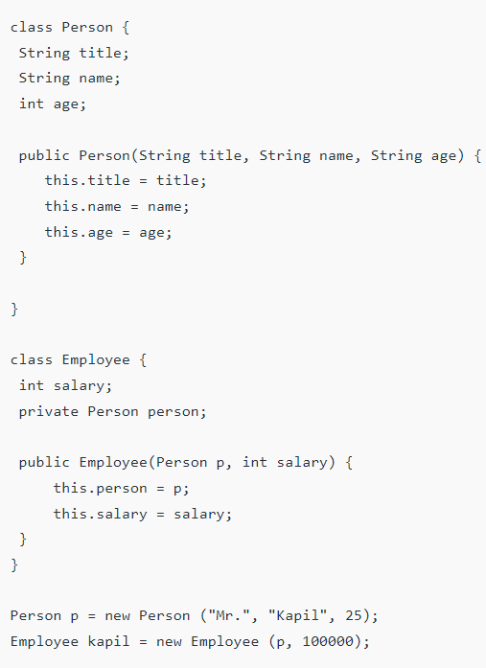
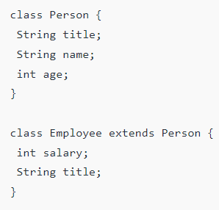
Composition
Inheritance
Notes:
The composition is typically “has a” or “uses a” relationship. Here the Employee class has a Person. It does not inherit from Person but instead gets the Person object passed to it, which is why it “has a” Person.
‹#›

Slide 8
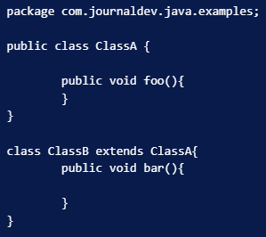
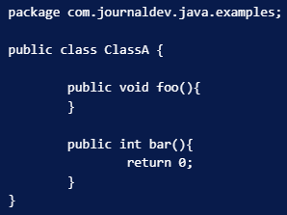
1. Inheritance is tightly coupled whereas composition is loosely coupled.
A new method bar() is added.
As soon as you start using new ClassA implementation, you will get compile time error in ClassB as The return type is incompatible with ClassA.bar(). The solution would be to change either the superclass or the subclass bar() method to make them compatible.

Slide 9
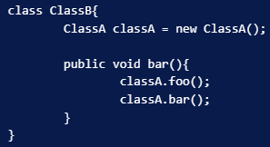
Cont..
If you would have used Composition over inheritance, you will never face this problem.

Slide 10
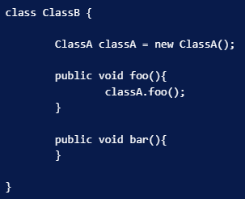
There is no access control in inheritance whereas access can be restricted in composition.
We expose all the superclass methods to the other classes having access to subclass. So if a new method is introduced or there are security holes in the superclass, subclass becomes vulnerable. Since in composition we choose which methods to use, it’s more secure than inheritance.
For example, we can provide ClassA foo() method exposure to other classes using below code in ClassB.
Notes:
We expose all the superclass methods to the other classes having access to subclass. So if a new method is introduced or there are security holes in the superclass, subclass becomes vulnerable. Since in composition we choose which methods to use, it’s more secure than inheritance. For example, we can provide ClassA foo() method exposure to other classes using below code in ClassB.
‹#›

Slide 11
Cont..
One more benefit of composition over inheritance is testing scope.
Unit testing is easy in composition because we know what all methods we are using from another class.
We can mock it up for testing whereas in inheritance we depend heavily on superclass and don’t know what all methods of superclass will be used. So we will have to test all the methods of the superclass.
This is extra work and we need to do it unnecessarily because of inheritance.

Slide 12
GoF Design Pattern Types
GoF Design Patterns are divided into three categories:
Creational: The design patterns that deal with the creation of an object.
Structural: The design patterns in this category deals with the class structure such as Inheritance and Composition.
Behavioral: This type of design patterns provide solution for the better interaction between objects, how to provide lose coupling, and flexibility to extend easily in future.
Notes:
https://www.digitalocean.com/community/tutorials/composition-vs-inheritance
‹#›

Slide 13
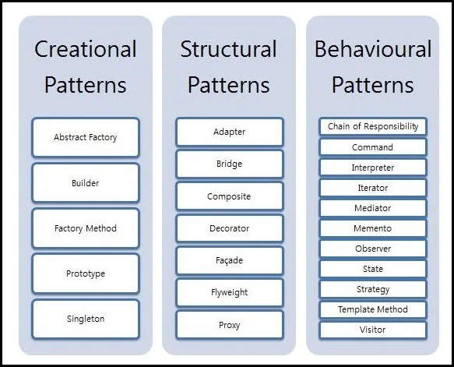

Slide 14
Design for Change
Identify the functionality that may change (frequently?)
Take special consideration in implementing such functionality in classes, so that the changing functionality will have minimized impact on the other parts
Use the principles of Protected Variation, Polymorphism, Indirection to provide a stable interface of the potentially varying functionality.
Notes:
Indirection introduces an intermediate unit to communicate between the other units, so that the other units are not directly coupled.
How to avoid impact of variations of some elements on the other elements. It provides a well defined interface so that the there will be no affect on other units.
‹#›

Slide 15
Design for Change – Write to Interfaces
The client classes are to be written in a way that they talk to the stable interface
Example – Handling Persistence
Probability of change?

Slide 16
Example – Handling Persistence
Student
Option 1
Write SQL Queries here
Problem?
save()
Business logic and DB service layers are merging
increase coupling
Cohesion reduced
create connection
Mention sql queries
Impact of change is global
A good OO design can be managed through by adding new classes
Notes:
‹#›

Slide 17
Example – Handling Persistence
Option 2
Write SQL Queries here
Benefits over Option 1
Problem?
Student
DBHandler
save()
saveStudent(this)

Slide 18
Example – Write to Interfaces
Option 3
Write to interfaces
Benefits over other options
Problem? When to initialize and how?
Student
PersistenceHandler
save()
saveStudent(this)
Student
PersistenceHandler
OracleDBHandler
XMLPersistence
Notes:
‹#›

Slide 19
Implementation
//Student
Class Student{
PersitenceHandler persHandler;
void save(){
persHandler.saveStudent(this);
}
void setPersitenceHandler (PersitenceHandler ph)
{
this.persHandler=ph;
}

Slide 20
// PersistenceHandler
Class PersistenceHandler{
void saveStudent(Student s)=0;
}

Slide 21
class OracleDBHandler extends PersistenceHandler{
void saveStudent(Student s){
//connection
//insert query formulation
//execute query
}
}
Notes:
‹#›

Slide 22
class XMLHandler extends PersistenceHandler{
void saveStudent(Student s){
//connection
//insert query formulation
//execute query
}
}
Notes:
‹#›

Slide 23
Void main()
{
PersitenceHandler handler= new FileHandler();
University uni= new University();
Uni. setPersitenceHandler(handler);
}

Slide 24
Factory
Creational Design Pattern
Notes:
‹#›

Slide 25
Factory
Also called Simple Factory or Concrete Factory
Problem
Who should be responsible for creating objects when there is complex creation logic or a desire to separate the creation responsibilities for better cohesion
Solution
Create a Pure Fabrication object called a Factory that handles the creation
Notes:
‹#›

Slide 26
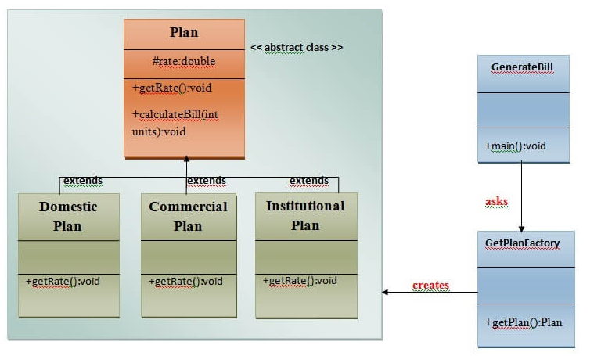

Slide 27
Factory
Who should be responsible to create PersistenceHandler class:
A PureFabrication object, so no information expert from domain
Important decision of which Persistence type to create
May require complex logic
Notes:
‹#›

Slide 28
Factory
If some domain object creates them,
the responsibilities of the domain object are going beyond pure application logic
This point underscores another fundamental design principle :
Design to maintain a separation of concerns
Separate distinct concerns into different areas, so that each has a cohesive purpose
Notes:
‹#›

Slide 29
Factory
Factory objects have several advantages:
Separate the responsibility of complex creation into cohesive helper objects.
Hide potentially complex creation logic.
Allow introduction of performance-enhancing memory management strategies, such as object caching or recycling.
Notes:
‹#›

Slide 30
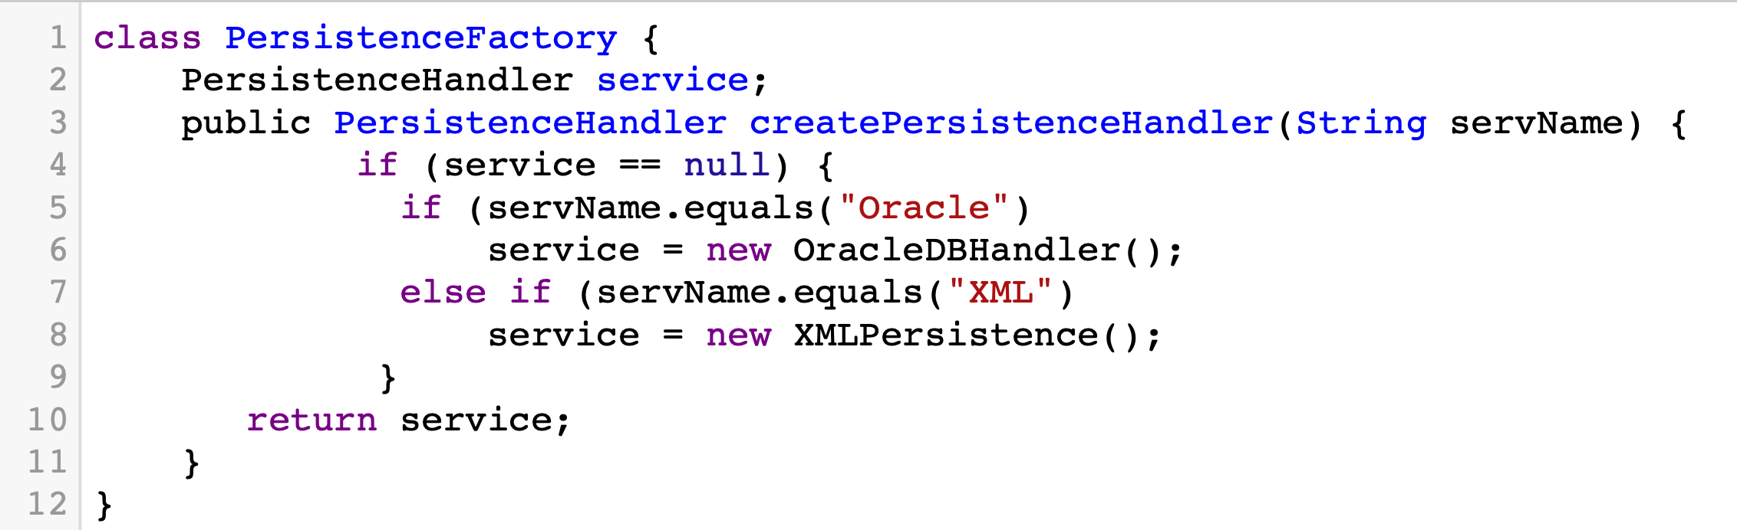
PersistenceFactory
service
PersistenceHandler
Student
OracleDBHandler
XMLPersistence
Notes:
class PersistenceFactory {
PersistenceHandler service;
public PersistenceHandler createPersistenceHandler(String servName) {
if (service == null) {
if (servName.equals("Oracle")
service = new OracleDBHandler();
else if (servName.equals("XML")
service = new XMLPersistence();
}
return service;
}
}
‹#›

Slide 31
Singleton
Notes:
‹#›

Slide 32

Singleton
This pattern involves a single class which is responsible to create an object while making sure that only single object gets created.
This class provides a way to access its only object which can be accessed directly without need to instantiate the object of the class.

Slide 33
Problem
Ensure that a class has just a single instance. Why would anyone want to control how many instances a class has? The most common reason for this is to control access to some shared resource—for example, a database or a file.
Provide a global access point to that instance. Singleton pattern lets you access some object from anywhere in the program. However, it also protects that instance from being overwritten by other code.

Slide 34
Solution
All implementations of the Singleton have these two steps in common:
Make the default constructor private, to prevent other objects from using the new operator with the Singleton class.
Create a static creation method that acts as a constructor. Under the hood, this method calls the private constructor to create an object and saves it in a static field. All following calls to this method return the cached object.
If your code has access to the Singleton class, then it’s able to call the Singleton’s static method. So whenever that method is called, the same object is always returned.
Notes:
a static method is a method that belongs to the class, rather than an instance of the class. Static methods are accessed through the class name, rather than an object of the class
‹#›

Slide 35
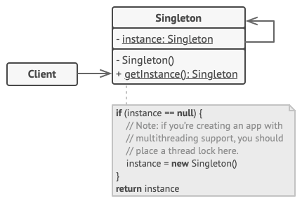
UML for Singleton
The Singleton class declares the static method getInstance that returns the same instance of its own class.
The Singleton’s constructor should be hidden from the client code. Calling the getInstance method should be the only way of getting the Singleton object.

Slide 36
Singleton
The PersistenceFactory raises another new problem in the design: Who creates the factory itself, and how is it accessed?
only one instance of the factory is needed within the process.
quick reflection suggests that the methods of this factory may need to be called from various places in the code
Thus, there is a visibility problem: How to get visibility to this single PersistenceFactory instance?
Notes:
‹#›

Slide 37
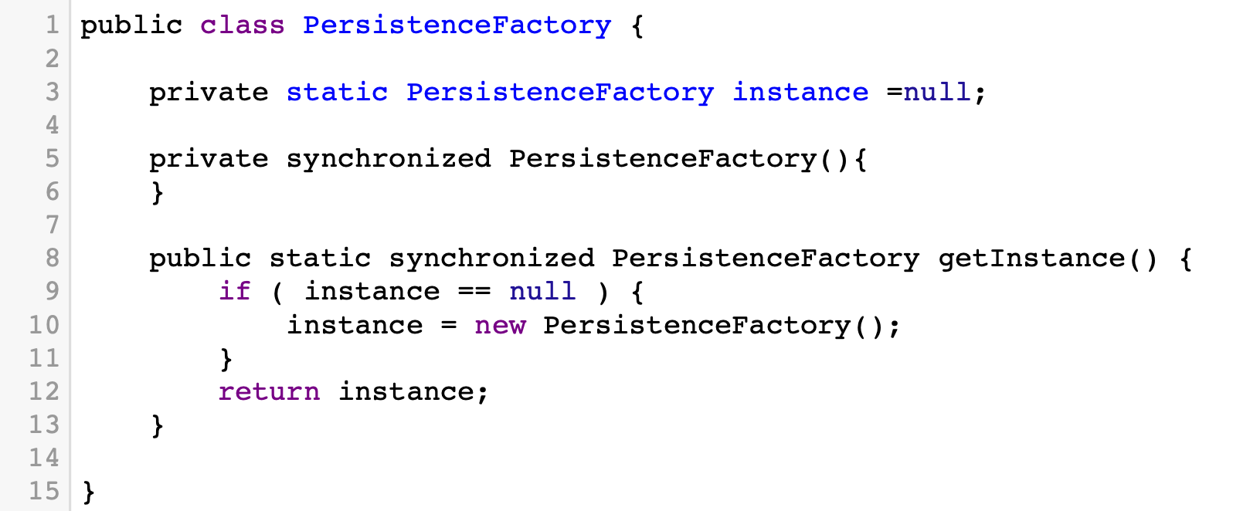
Notes:
‹#›
public class PersistenceFactory {
private static PersistenceFactory instance =null;
private synchronized PersistenceFactory(){
}
public static synchronized PersistenceFactory getInstance() {
if ( instance == null ) {
instance = new PersistenceFactory();
}
return instance;
}
}

Slide 38
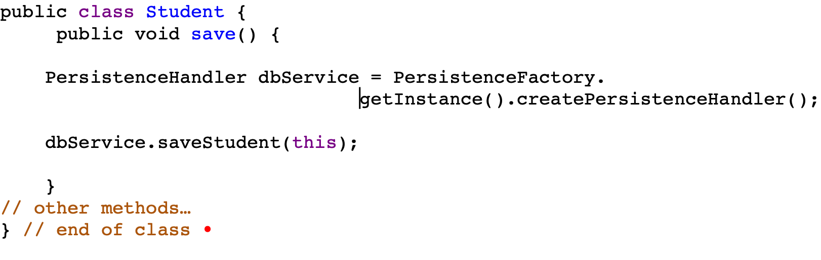
Notes:
‹#›
public class Student {
public void save() {
PersistenceHandler dbService = PersistenceFactory.getInstance().createPersistenceHandler();
dbService.saveStudent(this);
}
// other methods…
} // end of class

